Slide 1
Software Design and Architecture
Flyweight and Proxy Patterns

Slide 2
Design principles
High-level principles
‣ Single Responsibility
‣ Open/Closed
‣ Liskov Substitution Principle
‣ Interface Segregation
‣ Dependency Inversion
Low-level principles
‣ Encapsulate what varies
‣ Program to interfaces, not implementations
‣ Favor composition over inheritance
‣ Strive for loose coupling

Slide 3
Flyweight
Behavioral Patterns
observer
strategy
command
template
null object
state
iterator
Creational Patterns
factory method
abstract factory
singleton
builder
Structural Patterns
decorator
adapter
façade
composite
bridge
flyweight

Slide 4


Problem
You are to display a sequence of symbols that represent some ancient text.
Issue: each symbol of the alphabet is very big not Unicode character.
Text
Alphabet

Slide 5
Problem
Conceptually, a text is a sequence of symbols.

Slide 6
Solution
However, you must implement it differently than a typical sequence for efficiency
flyweight pool

Slide 7
Idea of Flyweight
Each object has intrinsic data and extrinsic
ex: characters in a String:
extrinsic = index position
intrinsic = value
Idea of Flyweight is to separate intrinsic data from extrinsic
2 classes now: Extrinsic + Intrinsic
extrinsic data can be supplied via calculation
intrinsic data is typically found in a file or database
Optionally, Intrinsic and Extrinsic objects are pooled
allocated from a pool and returned when no longer used

Slide 8
Flyweight Pattern
Use sharing to support large numbers of fine-grained objects efficiently

Slide 9
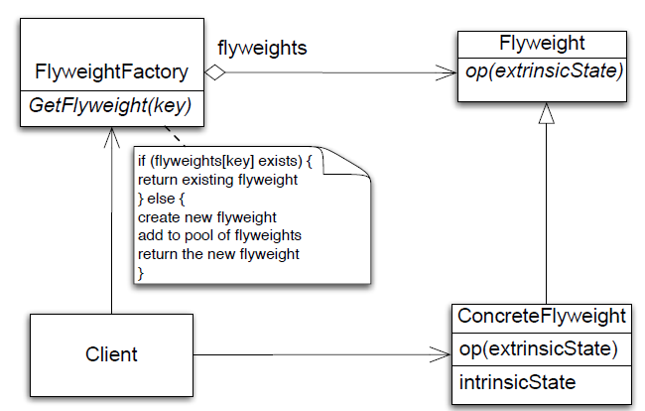
Class Diagram

Slide 10
Flyweight Participants
Flyweight
declares an interface through which flyweights can receive and act on extrinsic state
ConcreteFlyweight
implements Flyweight interface and adds storage for intrinsic state
FlyweightFactory
creates and manages flyweight objects
Client
maintains extrinsic state and stores references to flyweights

Slide 11
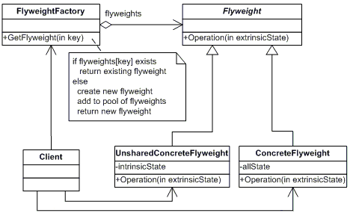
Flyweight Pattern
There can be huge numbers of objects that share the same data
Idea: split objects into sharable and non-sharable parts
Design below looks awfully complicated. Where does it come from?
any # of copies maintained
what’s the point?
why
factory?
at most one copy maintained

Slide 12
Derivation
Flyweight class is partitioned away from an Original class

Slide 13
Example
We want to create a system to represent all of the cars in a city. You need to store the details about each car ( model, and year) and the details about each car’s ownership (owner name, tag number, last registration date).
class CarHeavyWeight {
public Car ( model, year, owner, tag, renewDate) {
this.model = model;
this.year = year;
this.owner = owner;
this.tag = tag;
this.renewDate = renewDate;
{
//----------------------------------------------------------------
}

Slide 14
Example
Categorizing an object’s data as intrinsic or extrinsic: the physical car data ( model, year) is intrinsic, and the owner data (owner name, tag number, last registration date) is extrinsic. This means that only one car object is needed for each combination of model, and year.
/* Car class, optimized as a flyweight. */
class Car {
public Car ( model, year) {
this.model = model;
this.year = year;
}
//--------------------------------------
}

Slide 15
Example
Instantiation Using a Factory: Factory ensures that only a single copy of each unique intrinsic state is created:
/* CarFactory singleton. */
class CarFactory {
private Car createdCars [];
public Car createCar( model, year) {
// Check to see if this particular combination has been created
// before. otherwise create a new instance and save it.
if(! createdCars[ model + '-' + year]) {
var car = new Car(model, year);
createdCars[ model + '-' + year] = car;
}
return createdCars[model + '-' + year];
}
//------------------------------------------------------------------
}

Slide 16
Example
Extrinsic State Encapsulated in a Manager : All of the data that are not included in the Car objects has to be stored somewhere (CarRecord); you use a Singleton as a manager to encapsulate that data.
/* CarRecordManager singleton. */
class CarRecordManager {
private CarRecord carRecordDatabase [];
// Add a new car record into the city's system.
public void addCarRecord
(model, year, owner, tag, renewDate) {
car = CarFactory.createCar( model, year);
carRecordDatabase[tag] = {
owner: owner,
renewDate: renewDate,
car: car
}
}
//------------------------------------------------------------
}

Slide 17
Flyweight Participants
Collaborations
Data that a flyweight needs to process must be classified as intrinsic or extrinsic
Intrinsic is stored with flyweight; Extrinsic is stored with client
Clients should not instantiate ConcreteFlyweights directly
Consequences
Storage savings is a tradeoff between total reduction in number of objects verses the amount of intrinsic state per flyweight and whether or not extrinsic state is computed or stored
greatest savings occur when extrinsic state is computed

Slide 18
When to Use Flyweight
When all of the following are true
An application uses a large number of objects
Storage costs are high because of the sheer quantity of objects
Most object state can be made extrinsic
Many groups of objects may be replaced by relatively few shared objects once extrinsic state is removed
The application does not depend on object identity. Since flyweight objects may be shared, identity tests will return true for conceptually distinct objects

Slide 19
Proxy
Behavioral Patterns
observer
strategy
command
template
state
iterator
Creational Patterns
factory method
abstract factory
singleton
builder
Structural Patterns
decorator
adapter
façade
composite
bridge
flyweight
proxy

Slide 20
Problem
Objects talk to each other using an interface that has been overburdened with the needs of networking, security, access coherence, or historic versions of the interface.
an object demands too much of another object

Slide 21
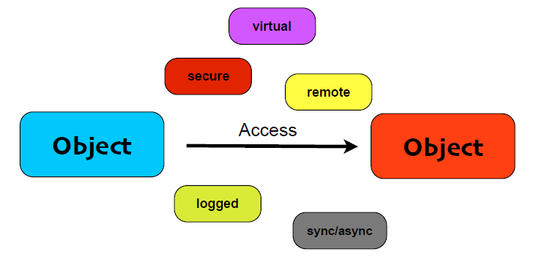
Object Access Control

Slide 22
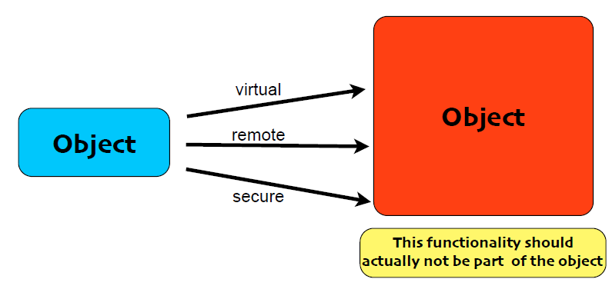
Object Access Control

Slide 23
The Proxy Pattern
The Proxy Pattern provides a surrogate or placeholder for another object to control access to it.

Slide 24
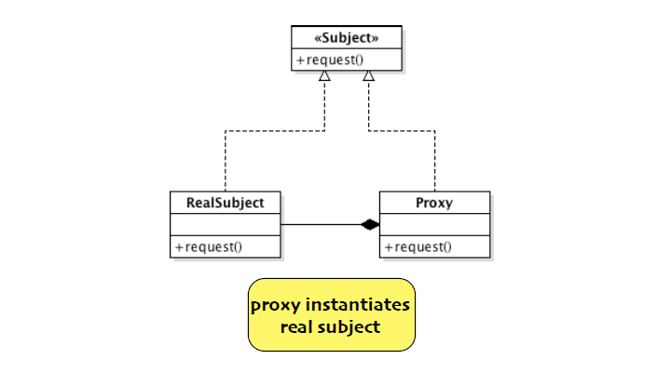
Class Diagram

Slide 25
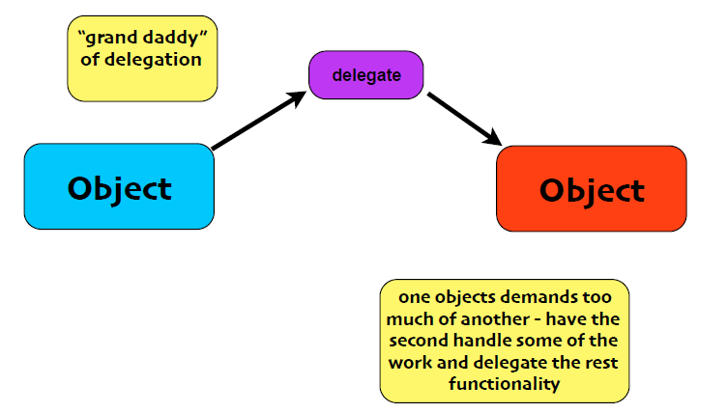
The Proxy Pattern

Slide 26
Types of proxies
Remote Proxy - Provides a reference to an object located in a different address space
Virtual Proxy - Allows the creation of a memory intensive object on demand
Protection Proxy - provides different clients with different levels of access
Cache Proxy - Temporary stores results of expensive target operations
Fire Wall Proxy - protects targets from bad clients
Synchronization proxy - provides multiple access to a target object
Smart reference Proxy - counting the number of references to an object

Slide 27
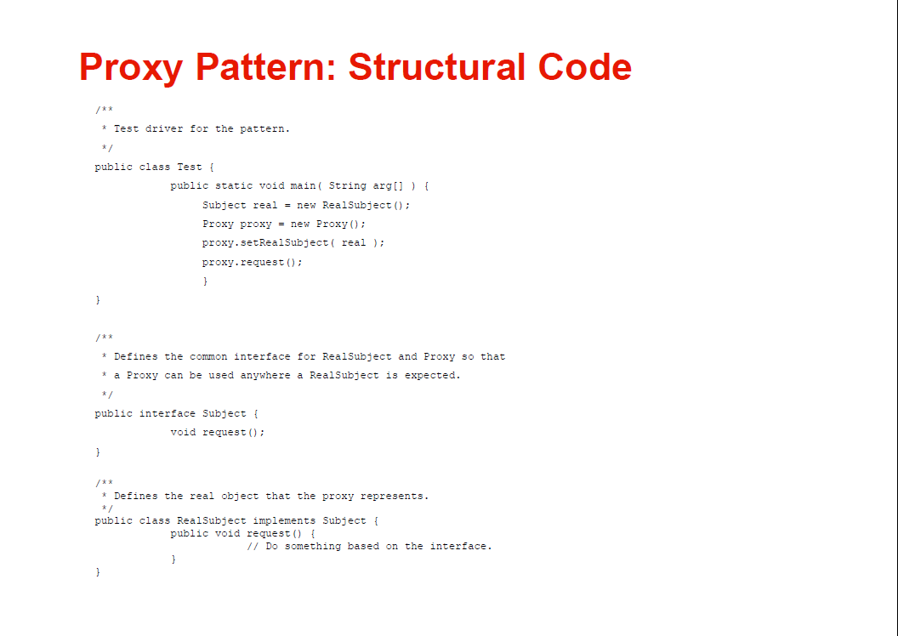

Slide 28
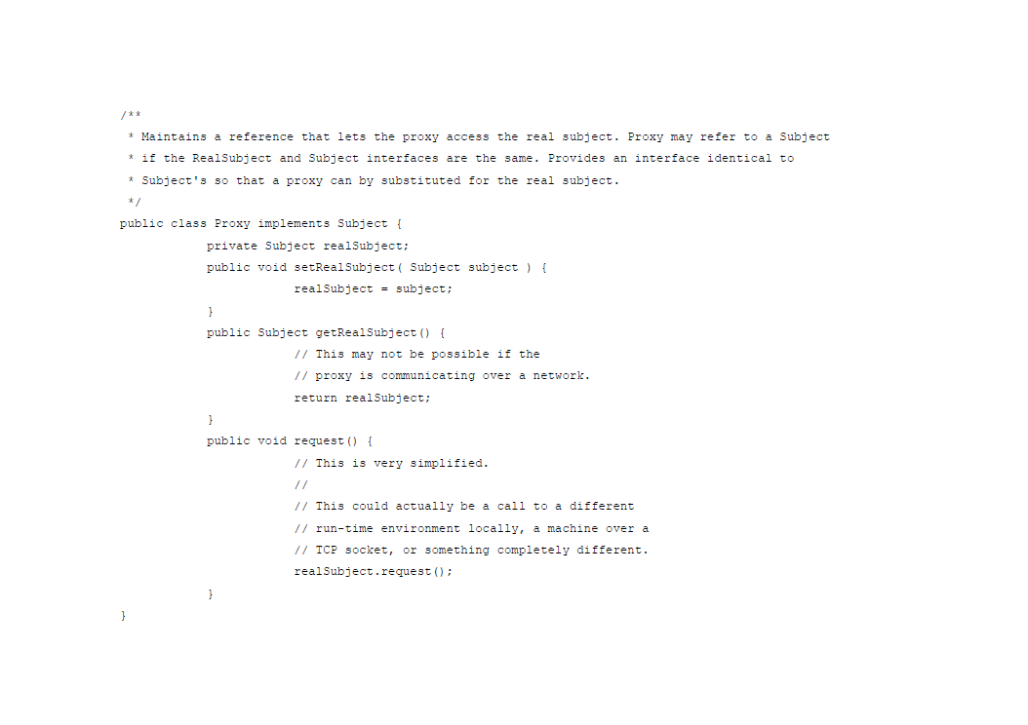

Slide 29
Proxy vs Decorator
Proxy is structurally similar to Decorator, but the two differ in their purpose.
The Decorator Pattern adds behavior to an object, while a proxy controls access to it.
Like any wrapper, proxies will increase the number of classes and objects in your design.

